Slide 1
Arrhythmia Detection on ECG Signals
in Modelling and Simulation
PREPARED BY:
Farangis Rezazadeh
Gohar Arshakyan
Kaushik Dey
Mohammadreza Shabani
Notes:
of GPS Data for Intelligent Route Planning

Slide 2
The Team

Slide 3
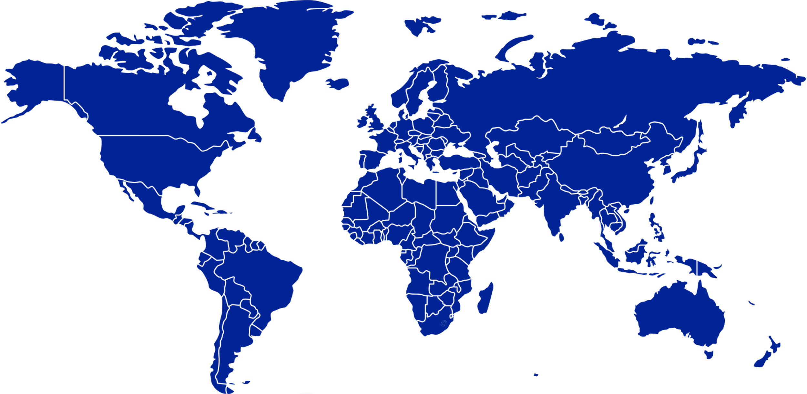



The Team

Slide 4
Agenda
Problem Background
Aim
Data-Engineering Mechanisms
Estimand and Target
Methodology
Performance measurement
Conclusion

Slide 5
Problem Background

Slide 6
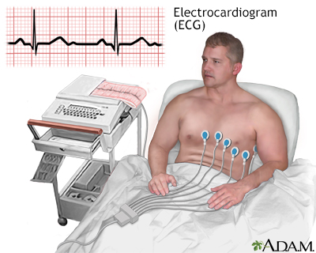
ECG Signal
An electrocardiogram (ECG) records:
these impulses to show how fast the heart is beating
the rhythm of the heart beats (steady or irregular)
the strength and timing of the electrical impulses as they move through the different parts of the heart.

Slide 7
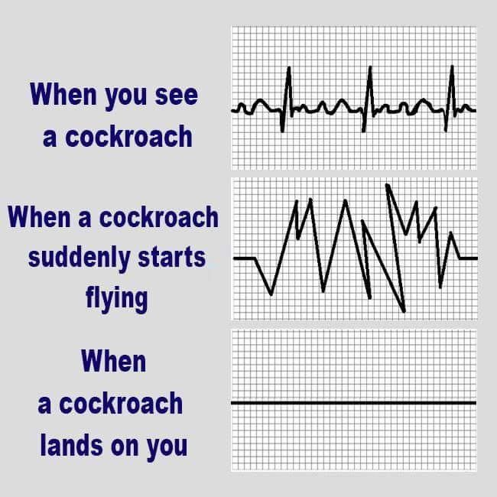

Arrhythmia
An arrhythmia, or irregular heartbeat, is:
A problem with the rate or rhythm of your heartbeat
Your heart may beat too quickly, too slowly, or with an irregular rhythm.
It is normal for your heart rate to speed up during physical activity and to slow down while resting or sleeping.

Slide 8

Arrhythmia Consequences
An arrhythmia can lead to:
Damage the heart, brain, or other organs.
A life-threatening stroke, heart failure, or cardiac arrest which can all be deadly.
During cardiac arrest, the heart suddenly and unexpectedly stops beating, causing death if it is not treated within minutes.

Slide 9
Aim

Slide 10

Aim
Arrhythmia detection from ECG signals
ADEMP framework adapted to simulation studies

Slide 11
Data-Engineering Mechanisms

Slide 12
Data-Engineering Mechanisms

Slide 13
Data-Engineering Mechanisms

Slide 14
Estimand and Target

Slide 15
Estimand and Target

Slide 16
Methodology DNN Random Forest

Slide 17
DNN

Slide 18
DNN
mm

Slide 19
Random Forest

Slide 20
Random Forest
dd

Slide 21
Performance measurement

Slide 22
Performance measurement
Models | CNN | DNN | Random Forest
Original Model F1 Score |  | 0.95 | 0.93
Average F1 Score for 100 Simulations |  | 0.96 | 0.97
Confidence Interval for F1 Scores |  | [0.95, 0.97] | [0.9782, 0.9787]
Simulation Time |  | 1:30 hrs | 2:30 hrs

Slide 23
Conclusions

Slide 24
Conclusions
dd

Slide 25


